Slide 1
Spectrum Management and 6G Midband Technology
RIT
EEEE.789
Shima Mashhadi
Jan 2025

Slide 2
RIT
Topics To Covers
Spectrum Management
International Telecommunication Union (ITU)
ITU-D
ITU-T
ITU-R
U.S. Spectrum Management
NTFA
NFAC
6G Technology
6G usage and capabilities
6G spectrum

Slide 3
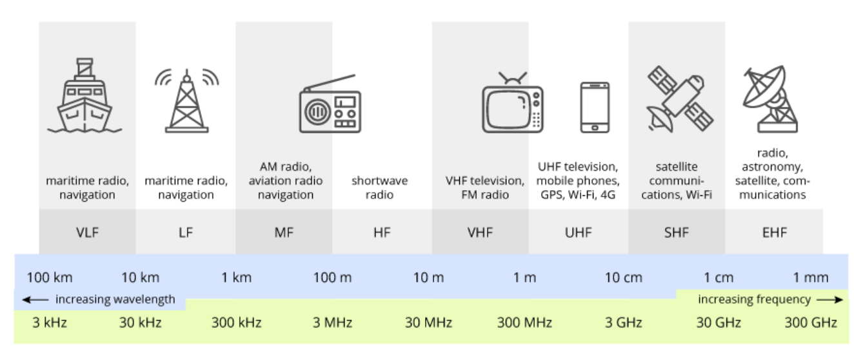
RIT
Spectrum management
Spectrum management is the process of regulating the use of radio frequencies.
frequency range from 10 kHz to 300 GHz.
https://www.google.com/url?sa=i&url=https%3A%2F%2Fterasense.com%2Fterahertz-technology%2Fradio-frequency-bands%2F&psig=AOvVaw0uh1QgjwdM0tgRg4UZArmg&ust=1737490876737000&source=images&cd=vfe&opi=89978449&ved=0CBQQjRxqFwoTCKj95JaQhYsDFQAAAAAdAAAAABAE

Slide 4






RIT
Spectrum management
Spectrum is reusable but finite resource.
The purpose of spectrum management is to mitigate radio spectrum pollution, and maximize the benefit of usable radio spectrum.
Governments around the world regulate who can use what part of the spectrum in what locations.
Electromagnetic Spectrum
Water
Mineral
Land
Gas
Natural Resource

Slide 5

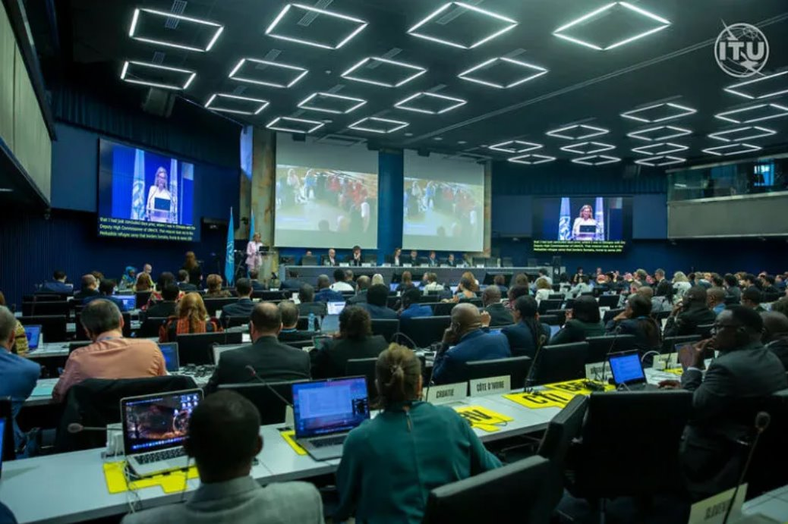

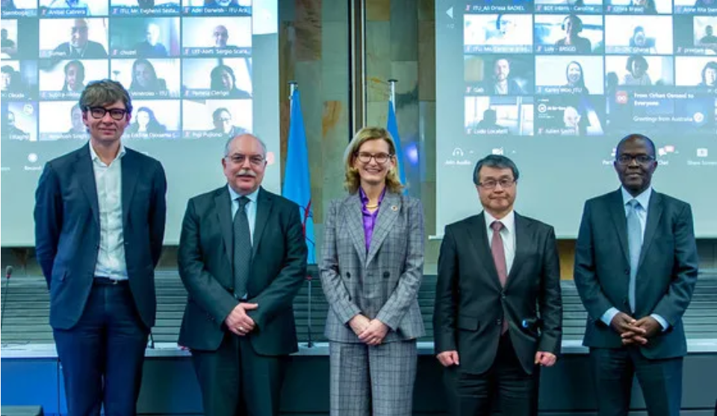
RIT
International Telecommunication Union (ITU)
About ITU

Slide 6
International Telecommunication Union (ITU)
RIT
Who They are
What they do
Why they matter
ITU is the United Nations specialized agency for information and communication technologies (ICTs).
ITU is the oldest agency in the UN family.
They allocate global radio spectrum and satellite orbits, develop the technical standards that ensure networks and technologies connect seamlessly.
Networks and devices everywhere rely on ITU's work.
https://www.itu.int/en/about/Pages/default.aspx

Slide 7
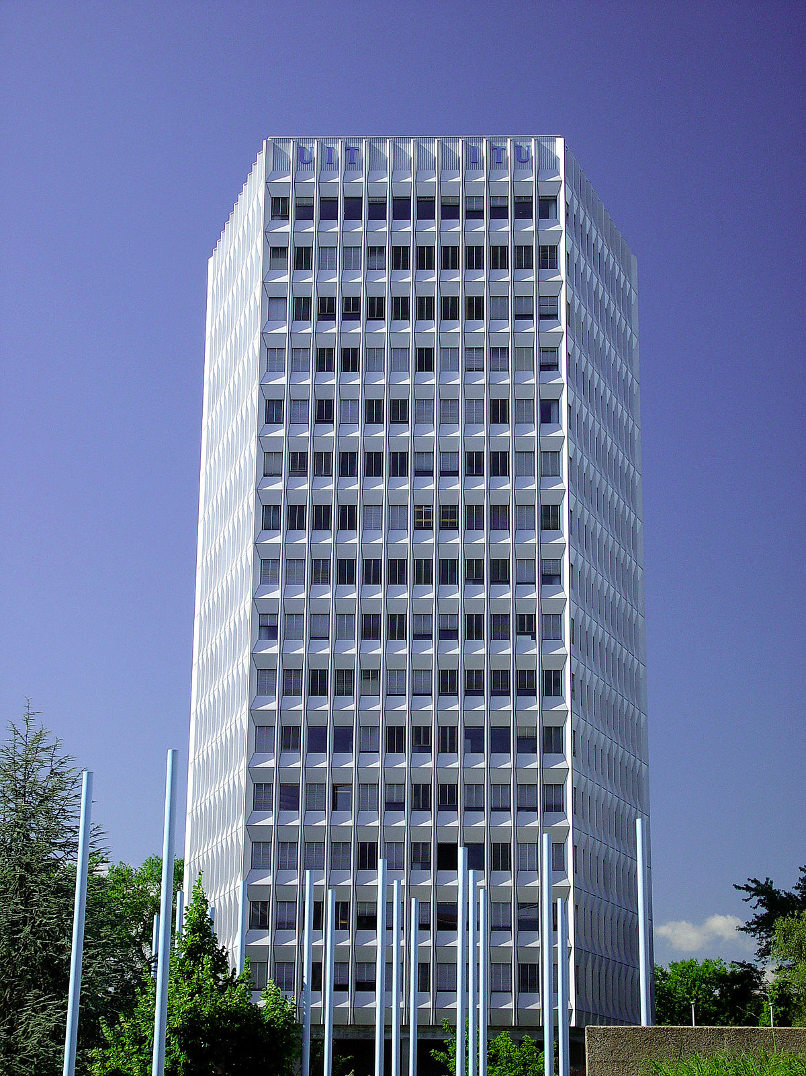
RIT
International Telecommunication Union (ITU)
Formation
The ITU was established in 1865 by the name of International Telegraph Union.
In 1934, it adopted its current name.
Headquarters
The headquarters of the ITU is situated in Geneva, Switzerland.
Members
The ITU has 194 member states, including all the member states of the United Nations.
https://commons.wikimedia.org/wiki/Category:International_Telecommunication_Union_Headquarters
https://www.itu.int/en/history/Pages/ITUsHistory.aspx

Slide 8
RIT
International Telecommunication Union (ITU)
ITU
Radio Communication
ITU-T
ITU-D
ITU-R
Telecommunication Developments
Telecommunication Standardization

Slide 9

RIT
ITU-D Telecommunication Development
Equitable, sustainable and affordable access to information and communication technologies (ICT).
Creating policies, regulation and providing training programs and financial strategies in developing countries.
The ITU-D hosts the World Telecommunication Development Conference (WTDC) every four years.
Two Study Groups: Enabling Environment for Meaningful connectivity, Digital Transformation.
https://www.itu.int/en/ITU-D/Pages/About.aspx
https://www.itu.int/en/ITU-D/Study-Groups/2022-2025/Pages/default.aspx
https://www.gp-digital.org/the-itu-a-brief-explainer/
https://en.wikipedia.org/wiki/ITU-D

Slide 10
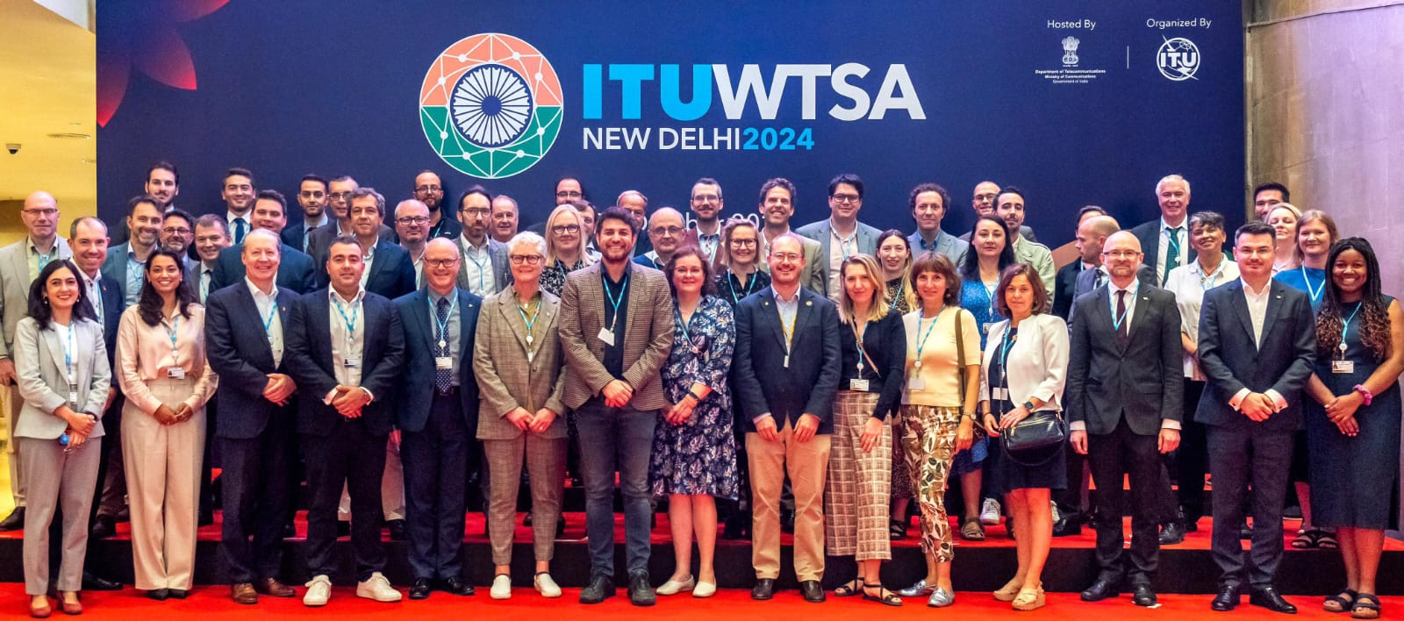
RIT
ITU-T Telecommunication Standardization
It is responsible for coordinating standards for telecommunication and ICT, Known as ITU-Recommendations.
The ITU-D host the World Telecommunication Standardization Assembly.
The technical work, the development of Recommendations, of ITU-T is managed by Study Groups (SGs). There are currently 11 SGs.
SG11 - Protocols, testing & combating counterfeiting
SG12 - Performance, QoS & QoE
SG13 - Future networks
SG17 - Security
^{https://www.itu.int/wtsa/2024/}
https://en.wikipedia.org/wiki/ITU-T#cite_note-4
https://www.itu.int/en/ITU-T/about/Pages/default.aspx
https://www.itu.int/wtsa/2024/
https://www.itu.int/en/ITU-T/studygroups/2025-2028/Pages/default.aspx

Slide 11

RIT
ITU-R Radio Communication
ITU-R defines and manages the international regulatory framework for the use of spectrum and satellite orbits.
Develop standards for radiocommunication systems.(ITU-R recommendations)
Each member country submits its proposal of spectrum allocation to ITU. After deliberate discussions on the received proposal in the meeting of all country members, decision are taken for opening of bands.
6 Study groups:
SG1: Spectrum management
SG4: Satellite Services
SG5: Terrestrial Services
https://www.itu.int/en/ITU-R/Pages/default.aspx
https://en.wikipedia.org/wiki/ITU-R
Radiocommunication Study Groups

Slide 12
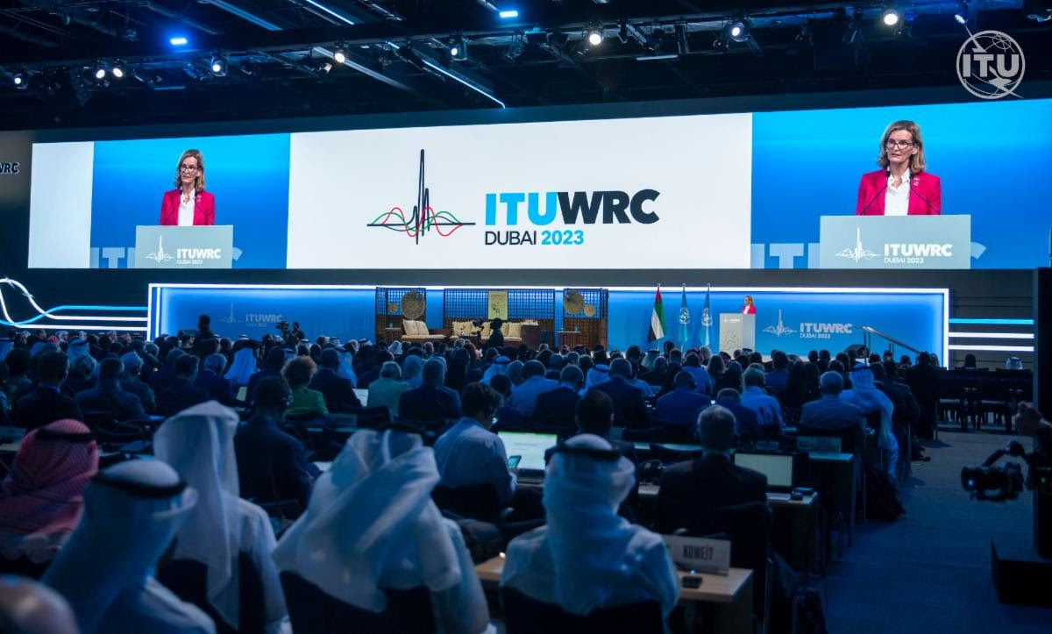
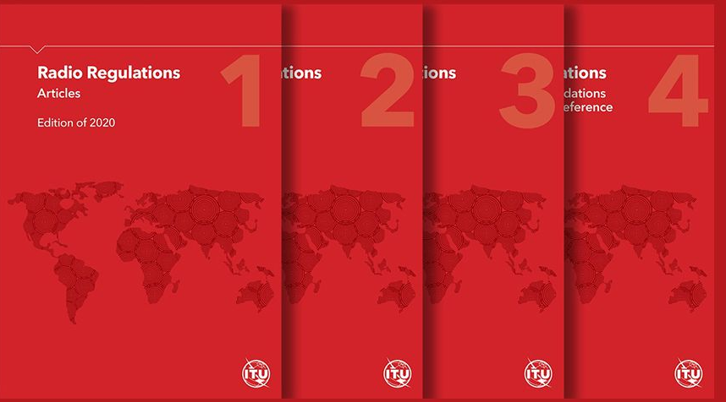
RIT
World Radiocommunication Conference (WRC)
The WRC is organized by ITU-R and held typically every 3 to 4 years in Geneva.
It allocates frequency bands to different applications, including mobile cellular communication (the business of 3GPP), which is called International Mobile Telecommunication (IMT) by ITU.
The Radio Regulations (RR) incorporate the decisions of the WRCs.
ITU Radio Regulations updated - ITU
World Radiocommunication Conferences (WRC)
ITU World Radiocommunication Conference 2023 opens in Dubai, UAE – IEEE ComSoc Technology Blog
ITU World Radiocommunication Conference 2023 opens in Dubai, UAE – IEEE ComSoc Technology Blog

Slide 13

RIT
Master International Frequency Register (MIFR)
Containing all registered frequency assignments.
Contains database of satellite and terrestrial frequency assignments.
Recording in the MIFR is the final stage of the frequency coordination process.
Confers international recognition and protection from interference.
https://www.itu.int/hub/2023/07/keeping-interference-in-check-seven-decades-of-itus-radio-frequency-circular/
Master International Frequency Register (MIFR)
https://ustti.org/wp-content/uploads/2019/11/Day-1-4_RR-and-allocations-table_20190903.pdf

Slide 14
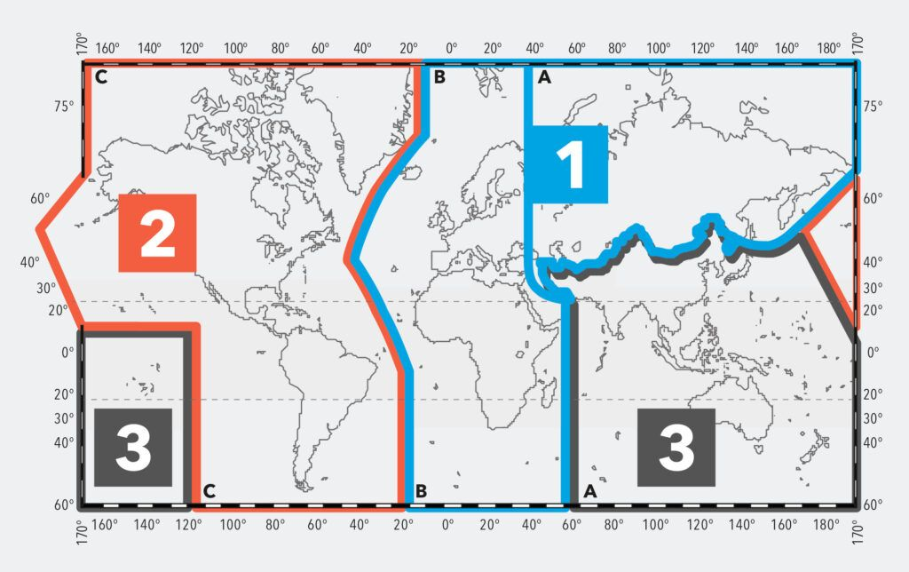
RIT
ITU-R Regions
The Radio Regulations, divides the world into three ITU regions for the purposes of managing the global radio spectrum.
https://www.itu.int/en/ITU-R/information/Pages/emergency-bands.aspx
https://www.itu.int/hub/2024/06/itu-helps-countries-achieve-robust-radio-frequency-planning/

Slide 15
RIT
ITU-R Radio Communication
ITU-R
USA: Federal Communications Commission (FCC)
European Conference of Postal and Telecommunications Administrations (CEPT)
India: Telecom Regulatory Authority of India (TRAI)
Inter-American Telecommunication Commission (CITEL)
African Telecommunications Union (ATU)
Rigonal Organizations
National Organization
UK: Office of Communications (Ofcom)

Slide 16

RIT
U.S. Spectrum Management
NTIA and FCC Jointly Manage Radio Spectrum in the U.S.
FCC = Federal Communications Commission
NTIA = National Telecommunications and Information Administration
National Spectrum Management
Communication ACT OF 1934
The Congress
FCC
Non-Federal Users
Business State & Local Government Commercial and Entertainment Private
Interdepartment Radio Advisory Committee (IRAC)
Chaired by NTIA. Representative from 19 federal Agencies
https://www.ntia.gov/book-page/who-regulates-spectrum
https://www.fcc.gov/engineering-technology/policy-and-rules-division/general/radio-spectrum-allocation?utm_source=chatgpt.com

Slide 17

RIT
U.S. Spectrum Management
NTIA and FCC Jointly Manage Radio Spectrum in the U.S.
FCC = Federal Communications Commission
NTIA = National Telecommunications and Information Administration
National Spectrum Management
Communication ACT OF 1934
The President
The Congress
NTIA
Federal Users
National Defense Law Enforcement & Security Transportation Resource Mgmt. & Control Emergencies
FCC
Non-Federal Users
Business State & Local Government Commercial Private
Interdepartment Radio Advisory Committee (IRAC)
Chaired by NITA. Representative from 19 federal Agencies
Notes:
https://www.ntia.gov/book-page/who-regulates-spectrum
https://www.youtube.com/watch?v=t9kZ_U5Dvy4

Slide 18
RIT
U.S. Spectrum Management
NTIA and FCC Jointly Manage Radio Spectrum in the U.S.
FCC = Federal Communications Commission
NTIA = National Telecommunications and Information Administration
National Spectrum Management
Communication ACT OF 1934
The President
The Congress
NTIA
Federal Users
National Defense Law Enforcement & Security Transportation Resource Mgmt. & Control Emergencies
FCC
Non-Federal Users
Business State & Local Government Commercial Private
Coordination
Advisory
Interdepartment Radio Advisory Committee (IRAC)
Chaired by NTIA. Representative from 19 federal Agencies
Liaison
Notes:
https://www.ntia.gov/book-page/who-regulates-spectrum
https://www.youtube.com/watch?v=t9kZ_U5Dvy4

Slide 19
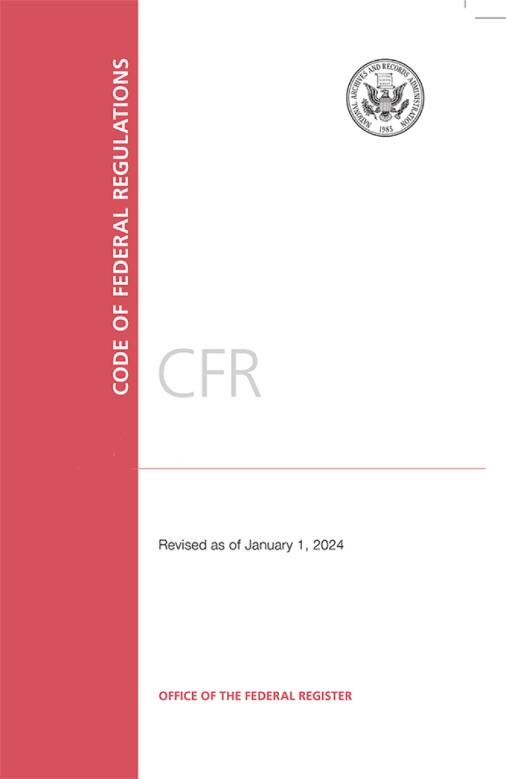
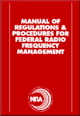
RIT
U.S. Spectrum Management
NTIA and FCC Jointly Manage Radio Spectrum in the U.S.
FCC = Federal Communications Commission
NTIA = National Telecommunications and Information Administration
National Spectrum Management
Communication ACT OF 1934
The President
The Congress
NTIA
Federal Users
National Defense Law Enforcement & Security Transportation Resource Mgmt. & Control Emergencies
FCC
Non-Federal Users
Business State & Local Government Commercial Private
Code of Federal Regulation
Coordination
Advisory
Interdepartment Radio Advisory Committee (IRAC)
Chaired by NTIA. Representative from 19 federal Agencies
Liaison
https://www.ntia.gov/publications/redbook-manual
https://bookstore.gpo.gov/products/code-federal-regulations-2024

Slide 20
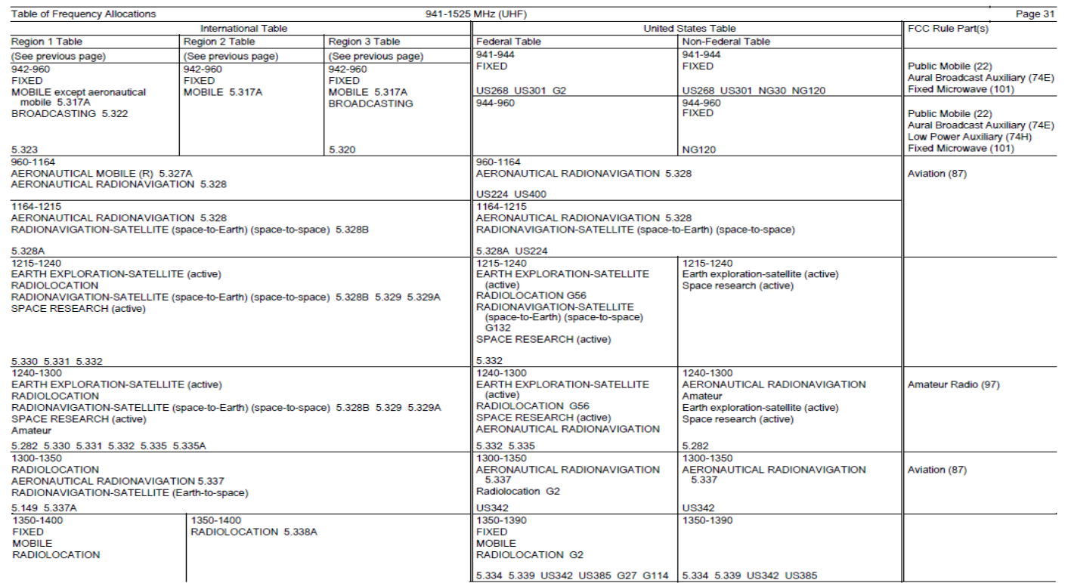
RIT
National Table of Frequency Allocations (NTFA)
https://transition.fcc.gov/oet/spectrum/table/fcctable.pdf

Slide 21
RIT
National Table of Frequency Allocations (NTFA)
National tables should be updated within the same cycle as WRC.
They are key for spectrum management at the national level and should be updated regularly to align with the latest version of the Radio Regulations.
includes frequency allocations at global and regional levels

Slide 22
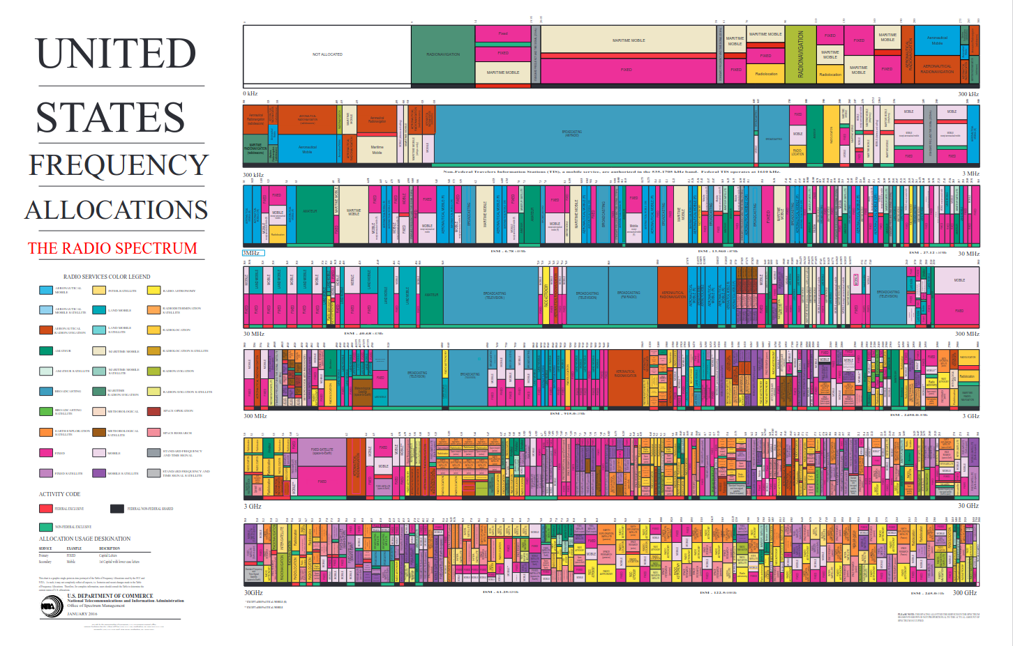
RIT
National Frequency Allocation Chart (NFAC)
https://www.ntia.gov/page/united-states-frequency-allocation-chart

Slide 23
RIT
National Frequency Allocation Chart (NFAC)
Frequency Bands: The chart divides the radio spectrum into frequency bands, typically ranging from a few kilohertz (kHz) to terahertz (THz).
LF (0-300 kHz)
MF (300 kHz -3 MHz)
HF (3MHz – 30 MHz)
VHF (30 MHz – 300 MHz)
UHF (300 MHz- 3 GHz)
SHF (3 GHz – 30 GHz)
EHF (30 GHz – 300 GHz)

Slide 24
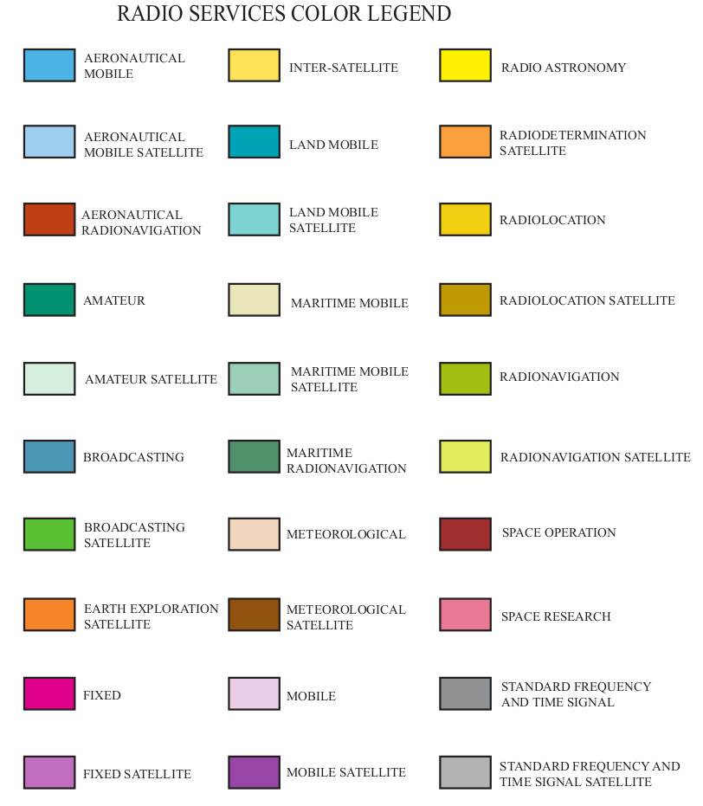
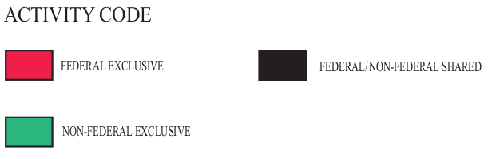
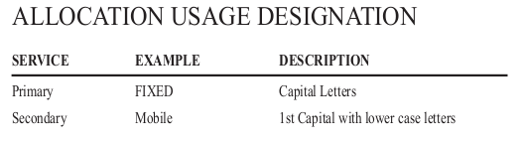
RIT
National Frequency Allocation Chart (NFAC)
Allocated Services: Each frequency band is assigned to specific services or applications.

Slide 25
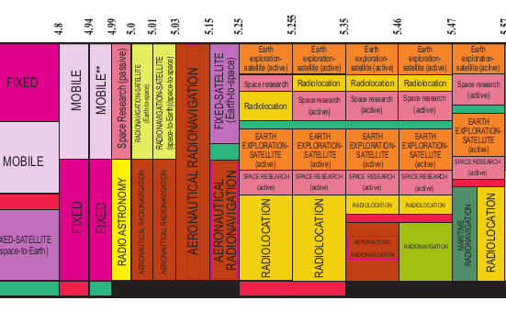
RIT
National Frequency Allocation Chart (NFAC)

Slide 26
RIT
Licensed and unlicensed band
Aspect | Licensed Spectrum | Unlicensed Spectrum
Access | Exclusive access granted to specific users | Open for anyone to use
Cost | Requires a fee for rights | No licensing fee, but usage rules apply
Usage Examples | Cellular networks, TV and radio broadcasting | Wi-Fi, Bluetooth, IoT devices
Interference Management | Well-managed with minimal interference | Shared usage, potential for interference

Slide 27


RIT
6 Generation Technology
Generated by ChatGPT

Slide 28
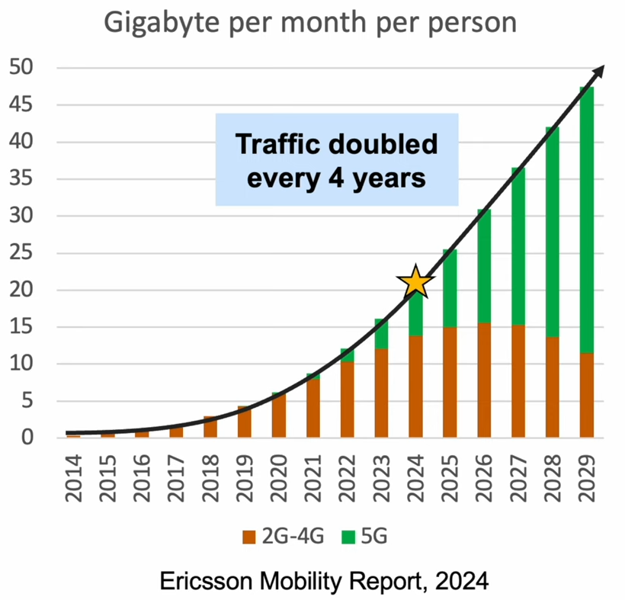
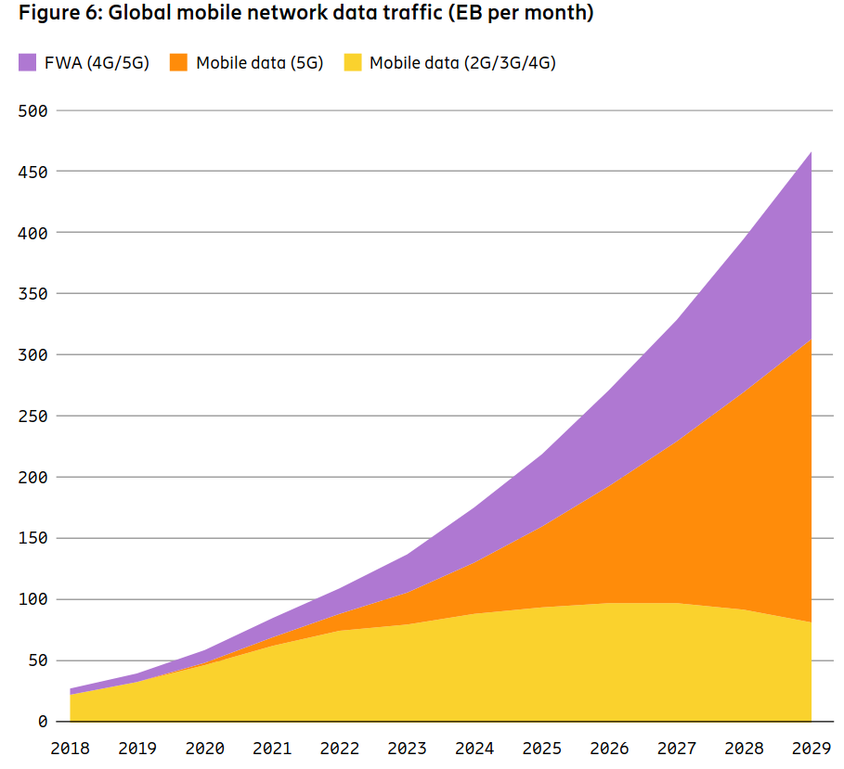
RIT
The need for 6G: Network Capacity Growth
From the latest Ericsson Mobility Report (EMR):​
Monthly data traffic per smartphone in North America increased: 13Gb to 20Gb (+54%) from 2021 to 2022 and is expected to triple (to 58Gb) by 2028.​
In those same periods, total monthly mobile traffic (all device types) increased from 4.6 to 6.7 Exabytes (EB) (+46%) and will increase to 21EB (21% CAGR)​
https://www.ericsson.com/49ed78/assets/local/reports-papers/mobility-report/documents/2024/ericsson-mobility-report-june-2024.pdf
https://www.fcc.gov/sites/default/files/Consolidated_6G_Paper_FCCTAC23_Final_for_Web.pdf

